Slide 1
Digital System Design
Tristate Buffers,
Read-Only Memories
and
Programmable Logic Devices
The slides included herein were taken from the materials accompanying
Fundamentals of Logic Design, 6th Edition, by Roth and Kinney,
and were used with permission from Cengage Learning.

Slide 2
Material to be covered …
Supplemental
Chapter 9: Sections 4 – 8
Fall 2010
ECE 331 - Digital System Design

Slide 3
Tristate Buffers
Fall 2010
ECE 331 - Digital System Design

Slide 4
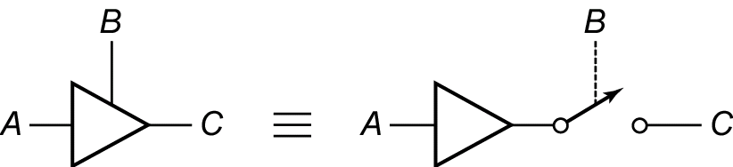
Tristate Buffer
A tristate buffer can output 3 different values:
  Logic 1 (high)
  Logic 0 (low)
  High-Impedance
control
input
output
Fall 2010
ECE 331 - Digital System Design

Slide 5
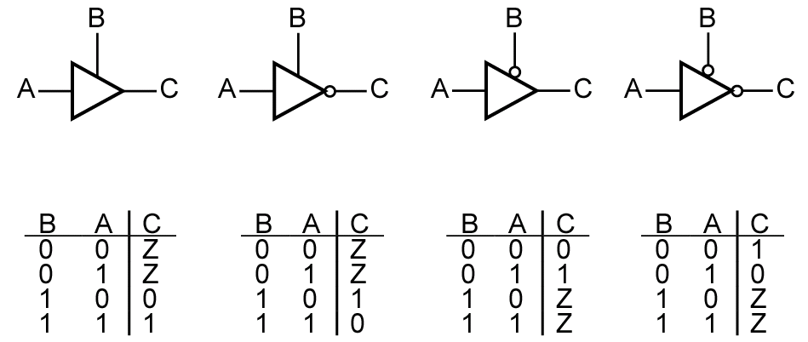
Tristate Buffers
Enable
Fall 2010
ECE 331 - Digital System Design

Slide 6
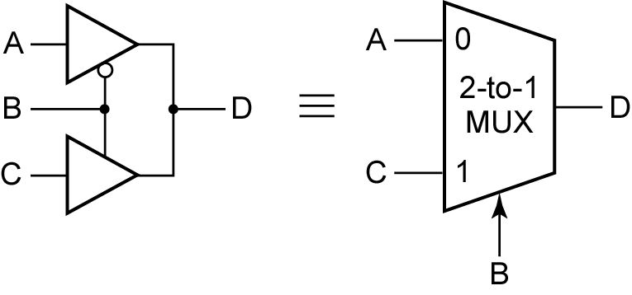
Building a Mux with Tristate Buffers
Fall 2010
ECE 331 - Digital System Design

Slide 7
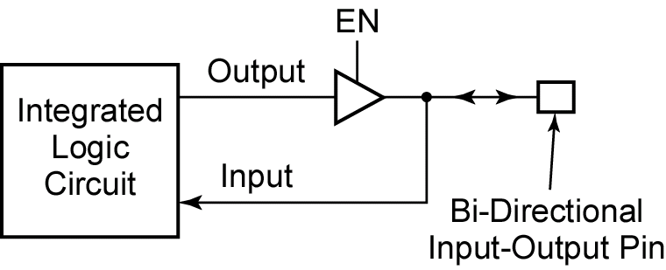
IC Bi-directional I/O Pin
Fall 2010
ECE 331 - Digital System Design

Slide 8
Read-Only Memories
Fall 2010
ECE 331 - Digital System Design

Slide 9
ROM
A read-only memory (ROM) consists of an array of semiconductor devices that are interconnected to store a set of binary data.
Once binary data is stored in the ROM, it can be read out whenever desired, but the data that is stored cannot be changed under normal operating conditions.
Data is written to the ROM once, and read from the ROM many times.
Fall 2010
ECE 331 - Digital System Design

Slide 10
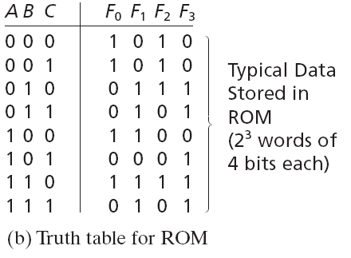
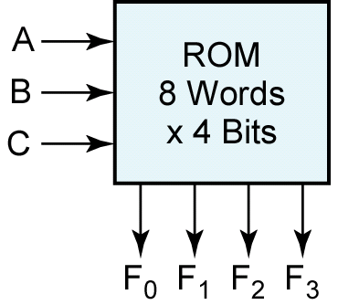
ROM
address
data
Fall 2010
ECE 331 - Digital System Design

Slide 11
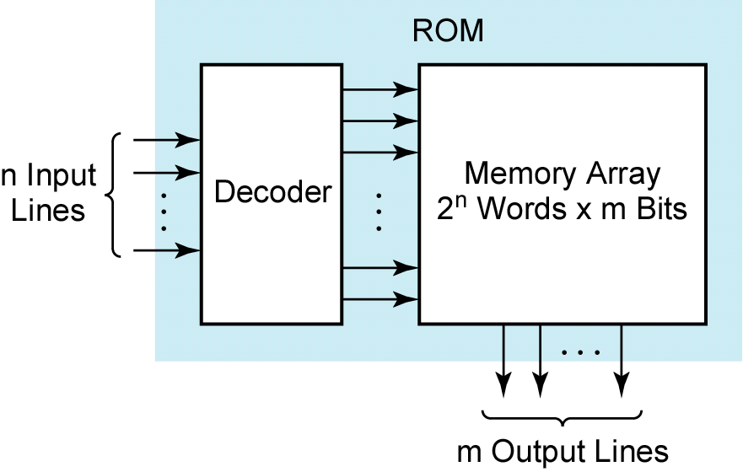
ROM – Basic Structure
address
data
Fall 2010
ECE 331 - Digital System Design

Slide 12
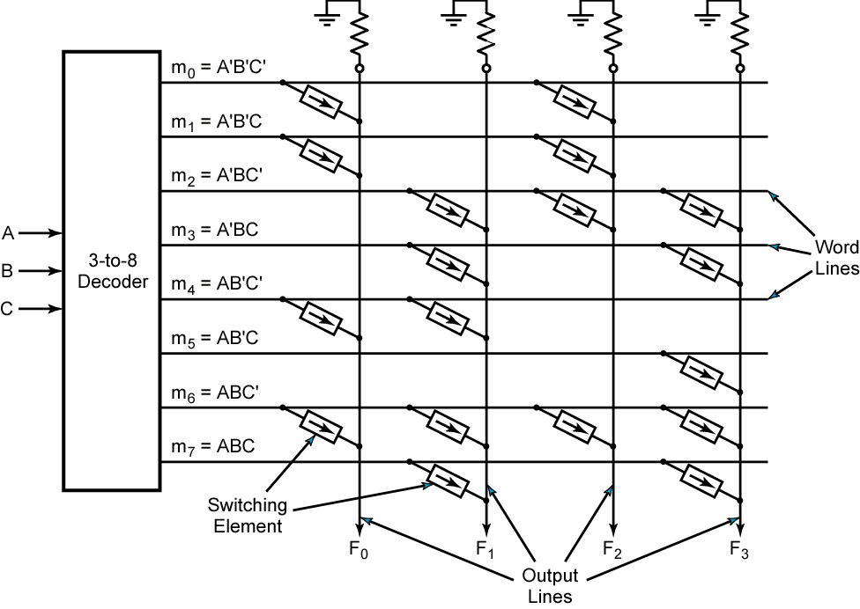
Building Logic Functions using ROM
F₀ = Σm(0, 1, 4, 6)
F₁ = Σm(2, 3, 4, 6, 7)
What functions are realized by the ROM for F₂ and F₃?
Fall 2010
ECE 331 - Digital System Design

Slide 13
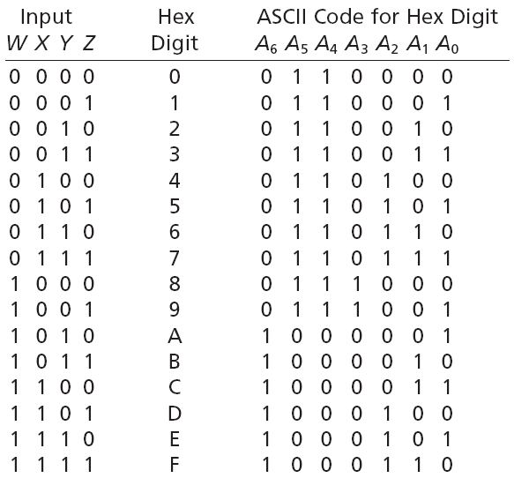
Building Logic Functions using ROM
Fall 2010
ECE 331 - Digital System Design

Slide 14
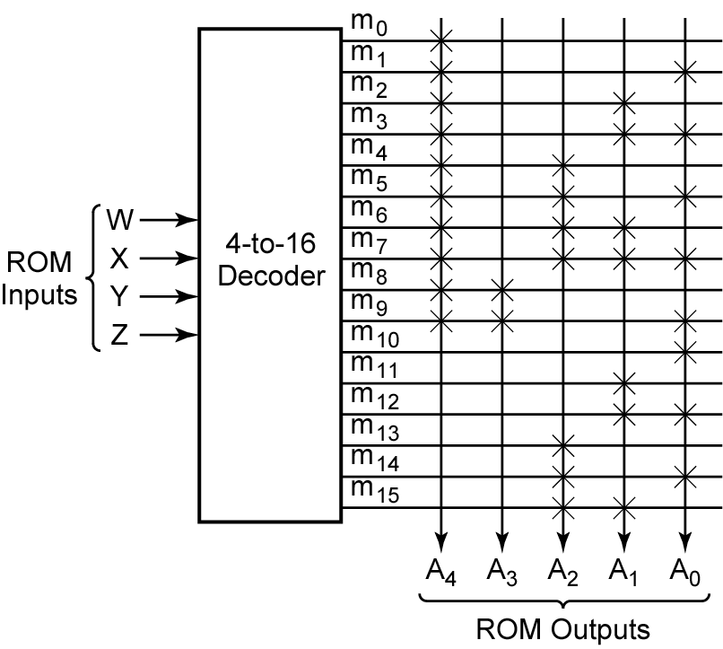
Building Logic Functions using ROM
Fall 2010
ECE 331 - Digital System Design

Slide 15
Programmable Logic Devices
Fall 2010
ECE 331 - Digital System Design

Slide 16
Programmable Logic Device
A programmable logic device (or PLD) is a general name for a digital integrated circuit capable of being programmed to provide a variety of different logic functions.
When a digital system is designed using a PLD, changes in the design can easily be made by changing the programming of the PLD without having to change the wiring in the system.
Fall 2010
ECE 331 - Digital System Design

Slide 17
Programmable Logic Arrays
A programmable logic array (or PLA) performs the same basic function as a ROM. A PLA with n inputs and m outputs can realize m functions of n variables.
The internal organization of the PLA is different from that of the ROM in that the decoder is replaced with an AND array which realizes selected product terms of the input variables. The OR array Ors together the product terms needed to form the output functions, so a PLA implements a sum-of-products expression.
Fall 2010
ECE 331 - Digital System Design

Slide 18
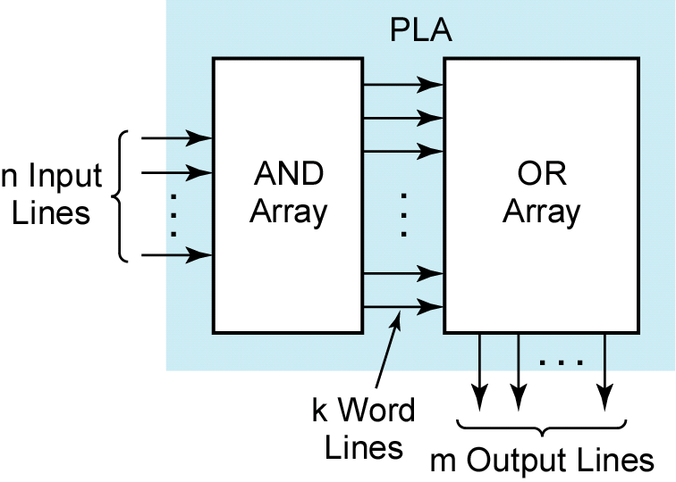
PLA – Basic Structure
Fall 2010
ECE 331 - Digital System Design

Slide 19
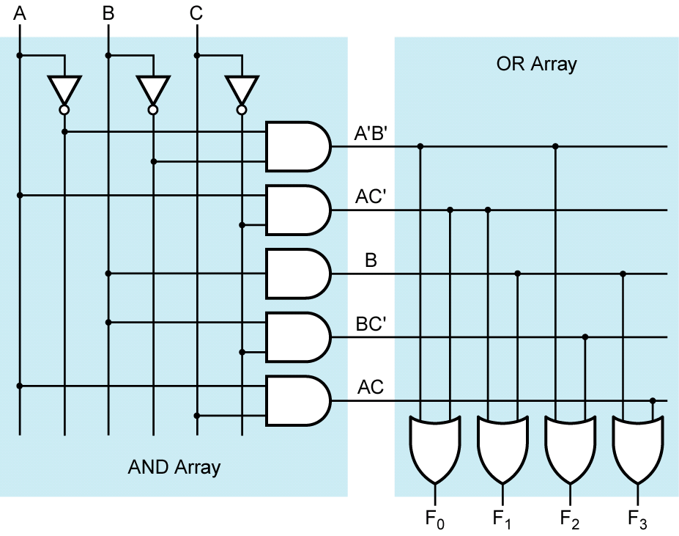
Building Logic Functions with PLA
F₀ = Σm(0, 1, 4, 6)
F₁ = Σm(2, 3, 4, 6, 7)
What functions are
realized by the ROM
for F₂ and F₃?
Fall 2010
ECE 331 - Digital System Design

Slide 20
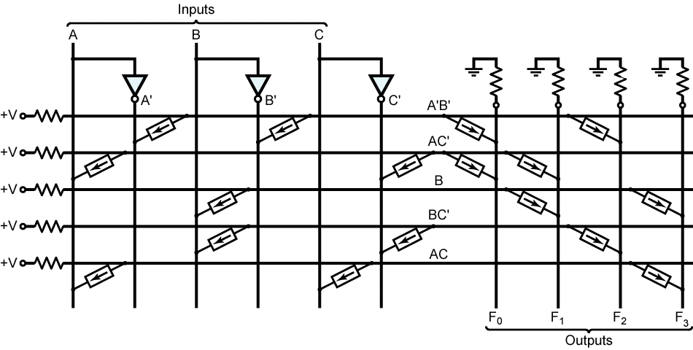
Building Logic Functions using PLA
Same functions as in previous slide.
Fall 2010
ECE 331 - Digital System Design

Slide 21
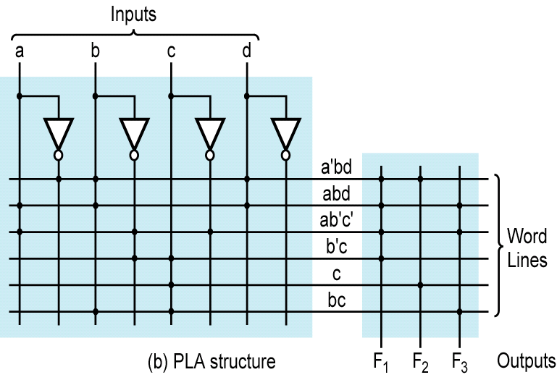
Building Logic Functions using PLA
Fall 2010
ECE 331 - Digital System Design

Slide 22
Programmable Array Logic
The programmable array logic (or PAL) is a special case of the PLA in which the AND array is programmable and the OR array is fixed.
Because only the AND array is programmable, the PAL is less expensive than the more general PLA, and the PAL is easier to program.
Fall 2010
ECE 331 - Digital System Design

Slide 23
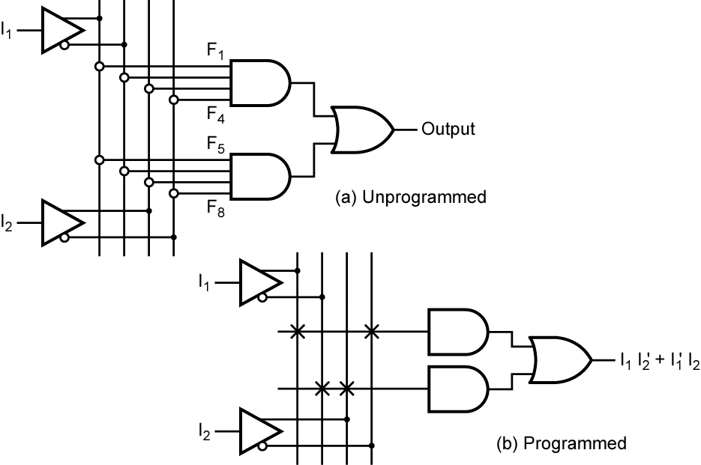
Building Logic Functions with PAL
Fall 2010
ECE 331 - Digital System Design

Slide 24
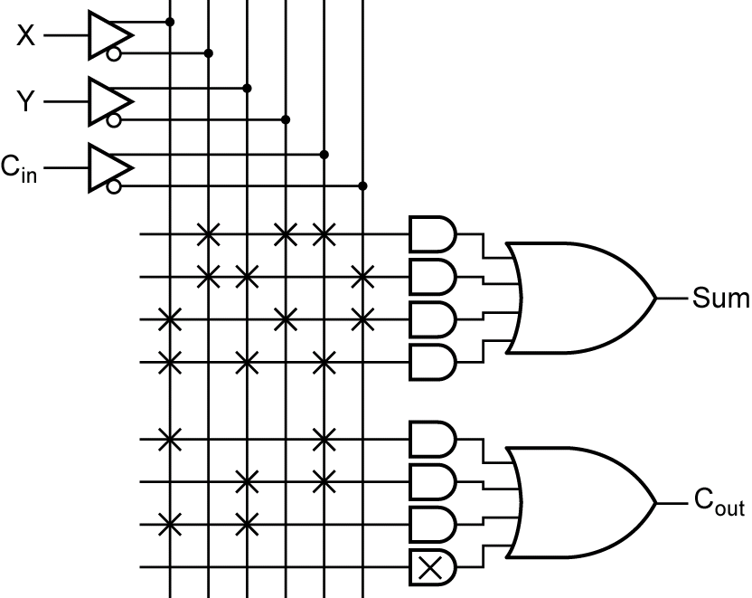
Building Logic Functions with PAL
Fall 2010
ECE 331 - Digital System Design

Slide 25
Complex Programmable Logic Devices
As integrated circuit technology continues to improve, more and more gates can be placed on a single chip. This has allowed the development of complex programmable logic devices (or CPLDs).
Instead of a single PAL or PLA on a chip, many PALs or PLAs can be placed on a single CPLD chip and interconnected.
When storage elements such as flip-flops are also included on the same integrated circuit (IC), a small digital system can be implemented with a single CPLD.
Fall 2010
ECE 331 - Digital System Design

Slide 26
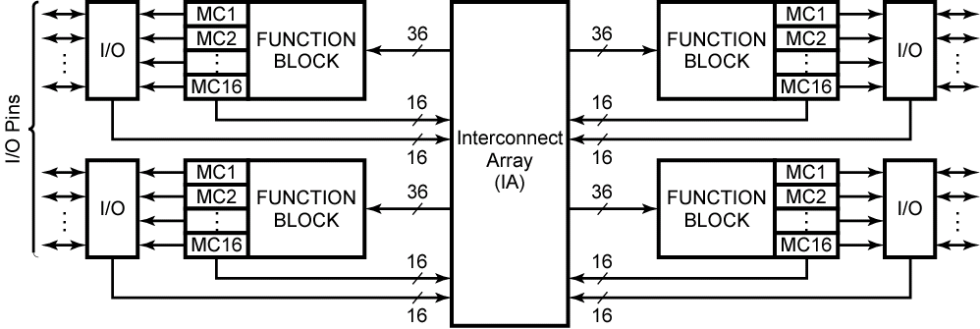
CPLD
Architecture of the Xilinx XCR3064XL CPLD
(Figure based on figures and text owned by Xilinx, Inc., Courtesy of Xilinx, Inc. © Xilinx, Inc.
1999-2003. All rights reserved.)
Fall 2010
ECE 331 - Digital System Design

Slide 27
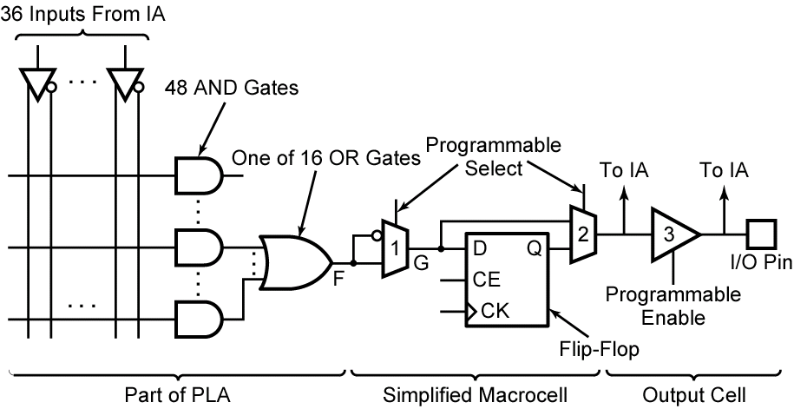
CPLD
CPLD Function Block and Macrocell
(A Simplified Version of XCR3064XL)
Fall 2010
ECE 331 - Digital System Design

Slide 28
Field Programmable Gate Arrays
A field-programmable gate array (or FPGA) is an IC that contains an array of identical logic cells with programmable interconnections. The user can program the functions realized by each logic cell and the connections between the cells.
The interior of the FPGA consists of an array of logic cells, also called configurable logic blocks (CLBs). The array of CLBs is surrounded by a ring of I/O interface blocks. These I/O blocks connect the CLB signals to IC pins.
Fall 2010
ECE 331 - Digital System Design

Slide 29
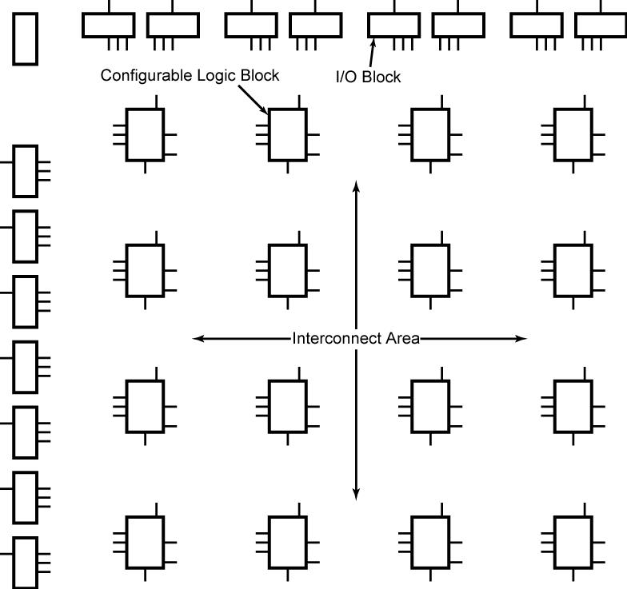
Layout of a Typical FPGA
Fall 2010
ECE 331 - Digital System Design

Slide 30
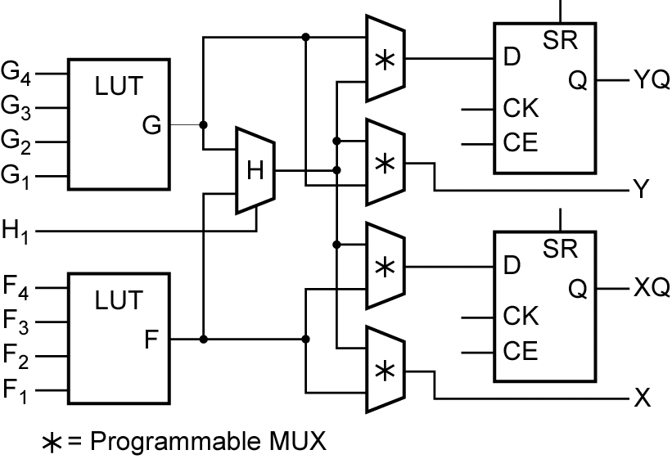
Simplified Configurable Logic Block
Fall 2010
ECE 331 - Digital System Design

Slide 31
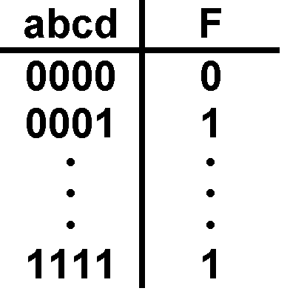
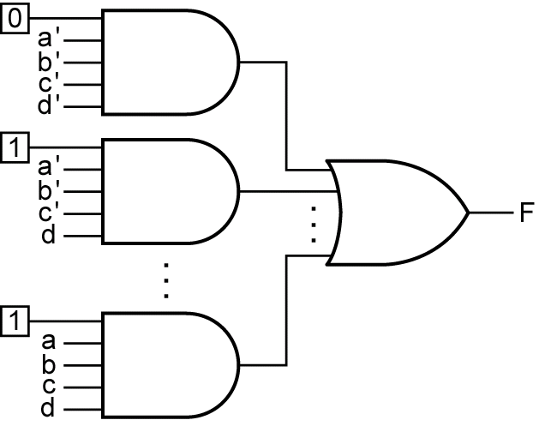
Implementation of a Lookup Table
A four-input LUT is essentially a reprogrammable ROM with 16 1-bit words.
Fall 2010
ECE 331 - Digital System Design

Slide 32
Questions?
Fall 2010
ECE 331 - Digital System Design

